Slide 1
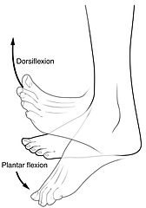
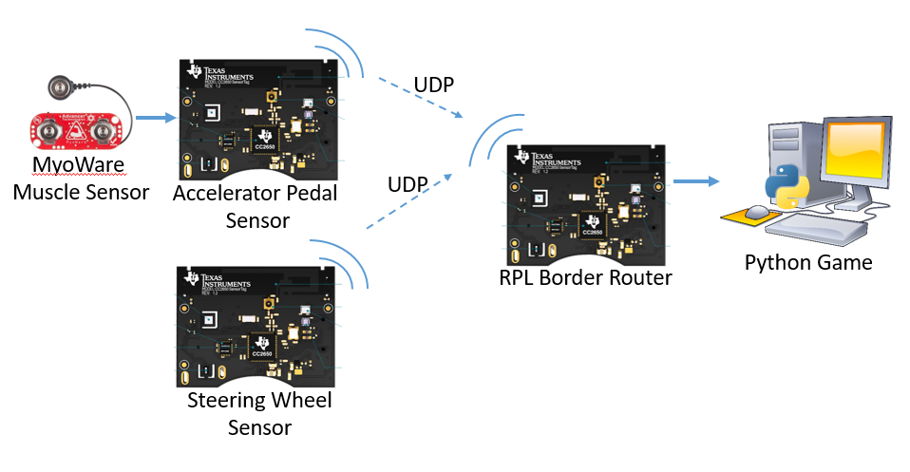
Gamification of Rehabilitation Using Muscle Sensors
Michael Redpath, Michael Garthe, Callum Sinclair, Athon Milane – Group L
PROJECT AIMS
Develop a car racing controller to assist with Human Rehabilitation
Games are a proven method to help patients rehabilitate.
Games have been shown to improve both physical and cognitive ability.
Interface with muscle sensors
Muscle sensors are used to capture the muscle activation of individual muscles as rehabilitative exercises are performed
Figure 1: Dorsiflexion and plantarflexion exercises (Cheprasov, 2018)
A computer game will guide patients through their exercises and use their muscle activation and movement data to provide them feedback on their exercises in a fun and interactive manner
Embedded System Capabilities
Capture the movement and muscle activation from several places on the patient as they perform exercises
Process the data to provide feedback to the patient in an interactive game environment
SYSTEM OVERVIEW
MyoWare Muscle Sensors
The muscle sensors can detect muscle activation by measuring the electromyography signals emitted by your muscles!
The electromyographic signals are cleaned by the MyoWare board and made available through an analogue interface
Muscles sensors will be placed on the [legs?] of the patient in order to measure the muscle activation associated with ankle movement
TI SensorTags
Onboard Accelerometer and gyroscope measure movement
ADC reads MyoWare output
Data is sent via radio to base station
Wireless Communication
UDP Packets
Non Storing RPL Network
Contiki nullMac and nullRDC protocols
Data Processing
[Sensor Fusion]
[Machine Learning]
Python Games
RESULTS
System Performance
[System perofmance vs AIMs]
SensorTag Performance
[Something about ADC output]
[Possible graph of output waveform or sensor positioning]
Network Performance
Machine Learning Performance
Game Performance
CONCLUSIONS
Further Work
Figure 1: System Overview

